Slide 1
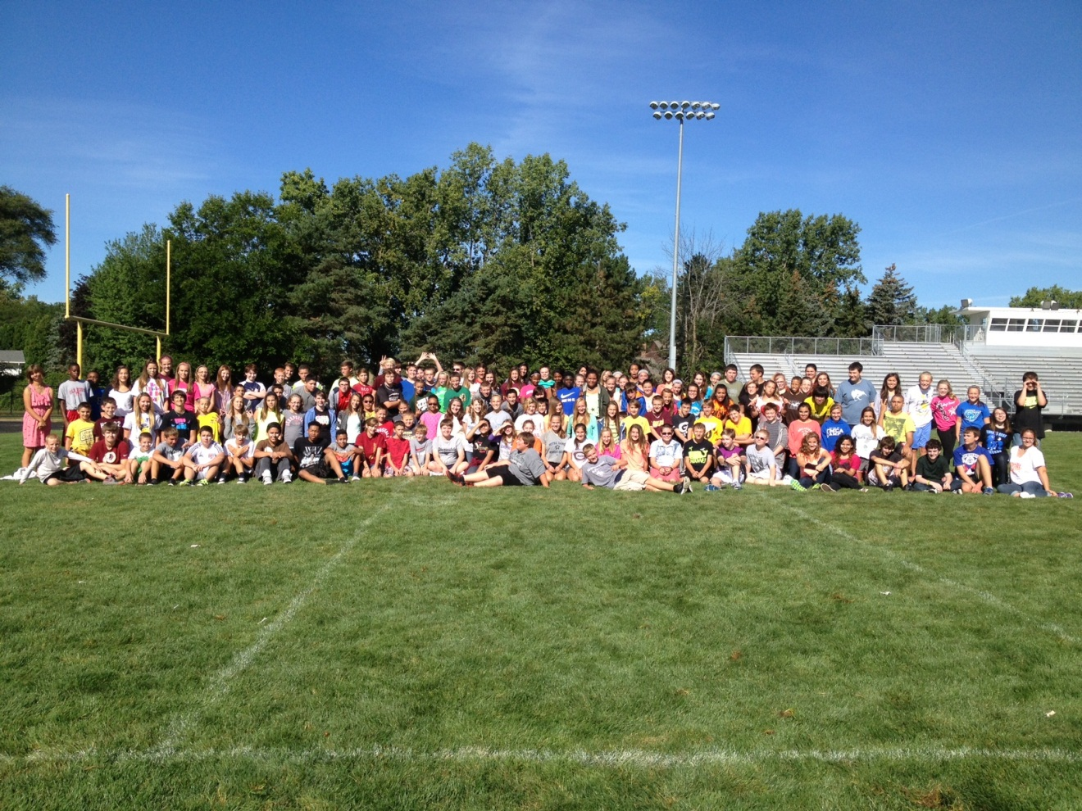
Welcome to Mrs. Stuart’s Class
Team 83

Slide 2
What is Algebra
Advanced Math Course in the 8th grade
Successful completion will give student High School Credit but grade point does not transfer
Units will include…
Algebra Basics
Equations
Functions
Linear Equations
Systems of Equations
Exponents and Exponential Functions
Polynomials
Quadratics

Slide 3
Teaching Style
Inquiry Based Learning
Much different than typical “process learning”
Students must “understand” the “what and why’s” of the content not just the “how”
Students will be collaborating with group members to discuss concepts and develop a conceptual understanding. The students will have to discover the concepts, it will not be given to them

Slide 4
Why is Inquiry Based instruction Important
Students retain information
If the student understands the “why and what” they have a greater chance of retaining the information and recalling it later. Will not require memorization rather understanding.
Common Core Standards
New State and Federal standards that forces students to become problem solvers and higher level thinkers
Assessments – Questions focus on understanding the content and not being able to just “do the Math”
M-Step
SAT

Slide 5
Classroom Packet
Highlights
Homework
Students should be correcting HWK online or in a.m.
Grade
80% is performance – tests & quizzes
20% is process – Daily assignments, homework, homework checks
Test retakes
Students are allowed 1 test retake per trimester
Need to fill out a test retake form
Quiz Retakes are not offered
Extra Credit is not offered

Slide 6
Progress Monitoring
Learning Targets
Homework Checks
Quizzes
Tests
Exams

Slide 7
Why is Algebra different than previous courses?
Abstract
Algebra takes elementary concepts and manipulates them in an abstract context
Analysis
Often there are multiple strategies that can be used and students need to analyze the problem to determine what strategy would be best
Increased number of word problems and creating algebraic equations from real-world situations
Very Dependent Upon Prior Knowledge
Students have a specific skill set they should come to Algebra with. If and need to seek help if they need review.
Students often start to learn study skills in this course.
Students need to actively engaged in the activities and discussions in class.

Slide 8
What does a successful Algebra student do?
Check Homework EVERY Night
Students were given directions to find the answers to the textbook problems online
It is recommended students check their homework answers as they are completing the homework
This allows students to identify misconceptions as they are working through their homework
Formative Assessments – Homework Checks (collection of problems that assess the Learning Targets they put in their journal)
Monitor students homework checks
Any score below 80% is a red flag that the student needs help.
Students should review all mistakes from a Homework Check.
Reflect, Reflect, Reflect
Students reflect on all mistakes from homework, homework checks, quizzes, tests and exams.
GET HELP WHEN NEEDED!!!!!!!
Activily engage in small group and whole group discussions and activities daily

Slide 9
Help Options
Tutoring every morning from 7:30-8:00
I have 1 TA available to answer questions
Student MUST bring questions with them
Student will be excused from being late to 1st hour
Tutorials on Mrs. Stuart webpage
Does not have tutorials for the first few review units.
Can also google topic to find tutorials online
Online Quizzes through the txt book
Code aea – chapter section
Example – aea-0102
Practice sheet on Mrs. Stuart’s Website
Study group with peers

Slide 10
Class flow
Algebra
Geometry
Allow for honors track sophomore year if student gets an A or above.
Honors Geometry
Allow for honors track beginning freshman year

Slide 11
Contact Information
Mrs. Stuart
Prefer Email
jstuart@gpsbulldogs.org
Phone
616-254-6617

Slide 12
I am looking forward to a GREAT year!
Any Questions?

